Slide 1
Planning Optimization
Ali Gorji Sefidmazgi
Optimization of PBUs case in Singapore
12/16/2021

Slide 2


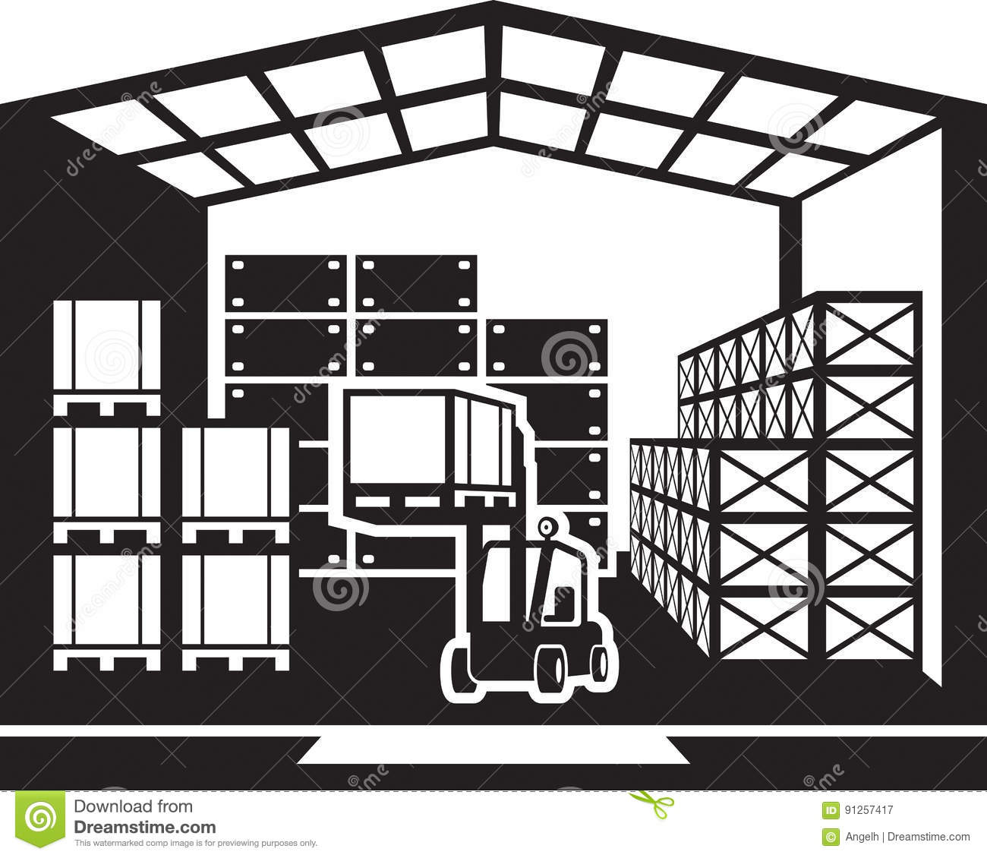
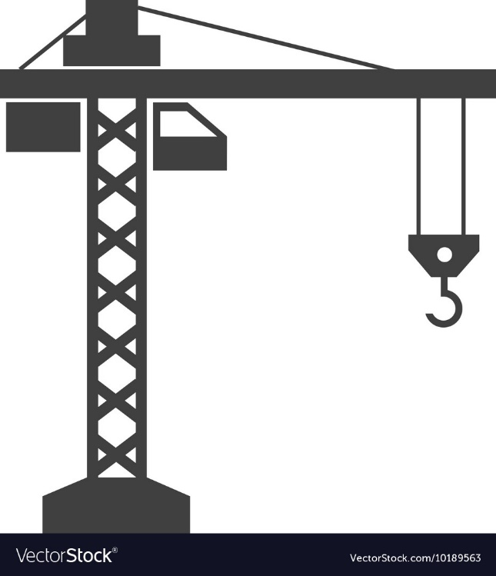
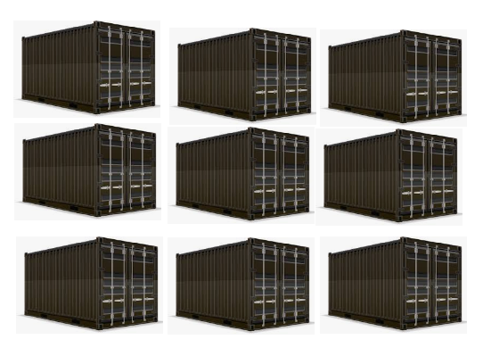
Problem Definition
Task
Delivery, hoisting and installation of PBUs in a construction site.
Optimizing the process to reduces warehouse cost and work force
Ship Warehouse Parking Hoist-Up Construction site
PBUs loaded from the warehouse into the parking
PBUs in parking
PBUs can be hoisted at each time frame
PBUs can be installed at each time frame

Slide 3
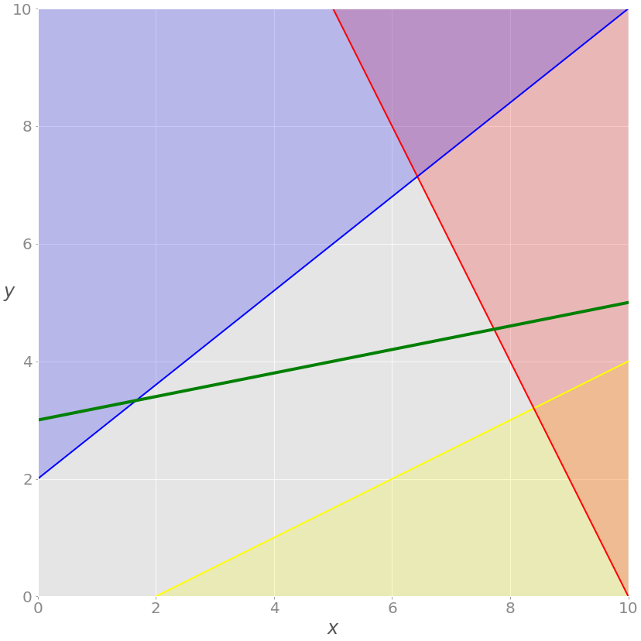

Linear Programming
A process of transforming a real-life situation into a mathematical model
Consists of a linear objective function of some decision variables
To be maximized or minimized
Under a finite number of linear constraints
$$minimiz\sum{c_{i}x_{i}}$$
$$subject to :$$
$a_{11}x_{1}+$ $a_{12}x_{2} …+a_{1n}x_{n}≥b_{1}$
$a_{21}x_{1}+$ $a_{22}x_{2} …+a_{2n}x_{n}≥b_{2}$
…
$a_{m1}x_{1}+$ $a_{m2}x_{2} …+a_{mn}x_{n}≥b_{m}$
$x_{1}$, $x_{1}$,… ,$x_{n}≥0$

Slide 4
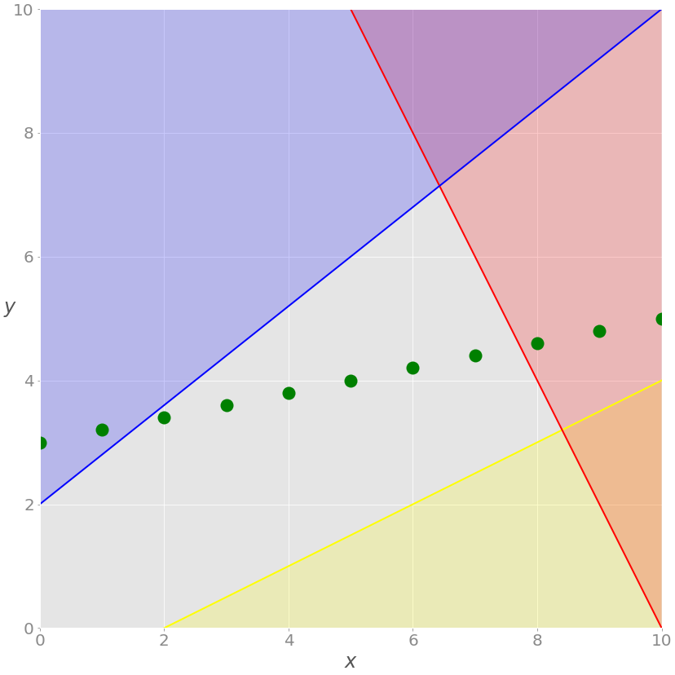
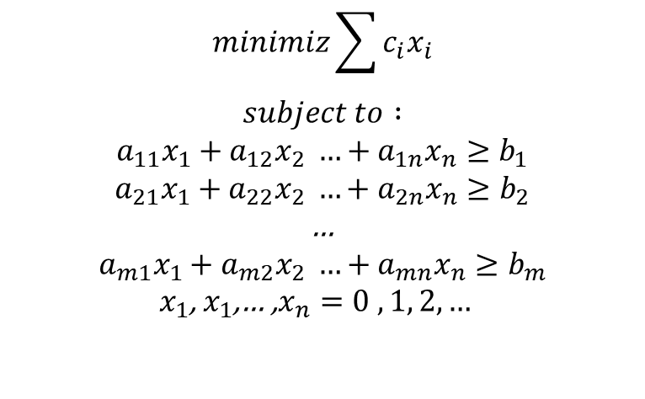
Integer programming
For some optimization problems the decision variables should take integer values.
Indivisible items, such as airplanes
Particular state, such as on or off
Planning of investments such as 0 or 1
$$minimiz\sum{c_{i}x_{i}}$$
$$subject to :$$
$a_{11}x_{1}+$ $a_{12}x_{2} …+a_{1n}x_{n}≥b_{1}$
$a_{21}x_{1}+$ $a_{22}x_{2} …+a_{2n}x_{n}≥b_{2}$
…
$a_{m1}x_{1}+$ $a_{m2}x_{2} …+a_{mn}x_{n}≥b_{m}$
$x_{1}$, $x_{1}$,… ,$x_{n}=0 , 1, 2, …$

Slide 5


Google OR-Tools
Open source software
Optimization
Integer and linear programming
OR-Tools is a set of components written in C++ but provides wrappers for Java, .NET and Python

Slide 6
Google OR-Tools Example
from ortools.linear_solver import pywraplp
solver = pywraplp.Solver.CreateSolver('GLOP')
Import and Create the linear solver with the GLOP backend
infinity = solver.infinity()
x = solver.NumVar(0.0, infinity, 'x')
y = solver.NumVar(0.0, infinity, 'y')
defining decision variables
solver.Add(x + 7 * y <= 17.5)
solver.Add(x <= 3.5)
solver.Add(x - y <= 2.0)
defining constraints
solution
solver.Maximize(x + 10 * y)
defining objective
status = solver.Solve()
solving
Number of variables = 2
Number of constraints = 3
Solution:
Objective value = 33.99999999999999
x = 5.999999999999998
y = 3.9999999999999996
if status == pywraplp.Solver.OPTIMAL:
print('Solution:')
print('Objective value =', solver.Objective().Value())
print('x =', x.solution_value())
print('y =', y.solution_value())
print solution

Slide 7




Defining Mathematical Relationship Between Variables
$$x delivery$$
$$x load$$
$$Y warehouse$$
$$Y parked$$
The number of the PBUs in the warehouse at time t =
The number of the PBUs in the warehouse at time t-1 +
the number of PBUs delivered to warehouse at time t -
the number of PBUs loaded from warehouse to parking at time t

Slide 8





Defining Mathematical Relationship Between Variables
$$x load$$
$$x hoist$$
$$Y warehouse$$
$$Y parked$$
$$Y hoist$$
The number of PBUs in parking at time t =
The number of PBUs in parking at time t-1 +
The number of PBUs loaded from warehouse to parking at time t –
The number of PBUs selected from the parking, and to be hoisted at time t

Slide 9






Defining Mathematical Relationship Between Variables
$$x hoist$$
$$x install$$
$$Y parked$$
$$Y hoist$$
$$Y installed$$
The number of PBUs which are hoisted at each time frame at time t =
The number of PBUs which are hoisted at each time frame at time t-1 +
The number of PBUs selected from the parking, and to be hoisted at time t –
The number PBUs selected from the hoisted ones, and to be installed at each time frame

Slide 10



Defining Mathematical Relationship Between Variables
$$x install$$
$$Y hoist$$
$$Y installed$$
The Number of PBUs selected from the hoisted ones, and to be installed at each time frame at time t =
The Number of PBUs selected from the hoisted ones, and to be installed at each time frame at time t-1 +
The number of PBUs selected from the hoisted ones, and to be installed at each time frame

Slide 11
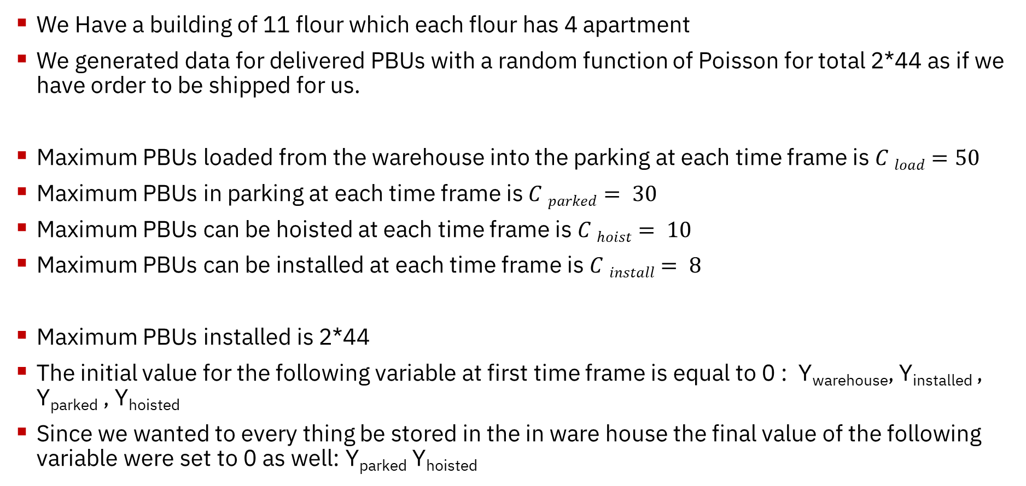
Input Data
We Have a building of 11 flour which each flour has 4 apartment
We generated data for delivered PBUs with a random function of Poisson for total 2*44 as if we have order to be shipped for us.
Maximum PBUs loaded from the warehouse into the parking at each time frame is $C load=50$
Maximum PBUs in parking at each time frame is $C parked= 30$
Maximum PBUs can be hoisted at each time frame is $C hoist= 10$
Maximum PBUs can be installed at each time frame is $C install= 8$
Maximum PBUs installed is 2*44
The initial value for the following variable at first time frame is equal to 0 : Y_{warehouse}, Y_{installed} , Y_{parked} , Y_{hoisted}
Since we wanted to every thing be stored in the in ware house the final value of the following variable were set to 0 as well: Y_{parked} Y_{hoisted}

Slide 12


KPIs
We want to minimize the number of PBUs in the warehouse
We want to maximize the number of PBUs installed
We want to minimize the number of PBUs in the warehouse at the same time
We want to maximize the number of PBUs installed

Slide 13
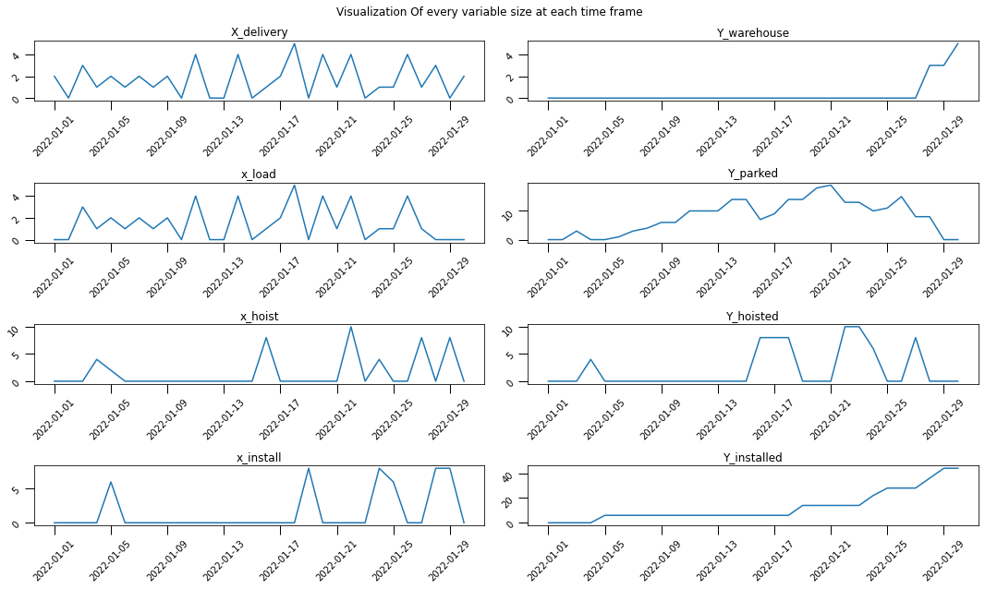
Simulation – Minimizing Warehouse

Slide 14
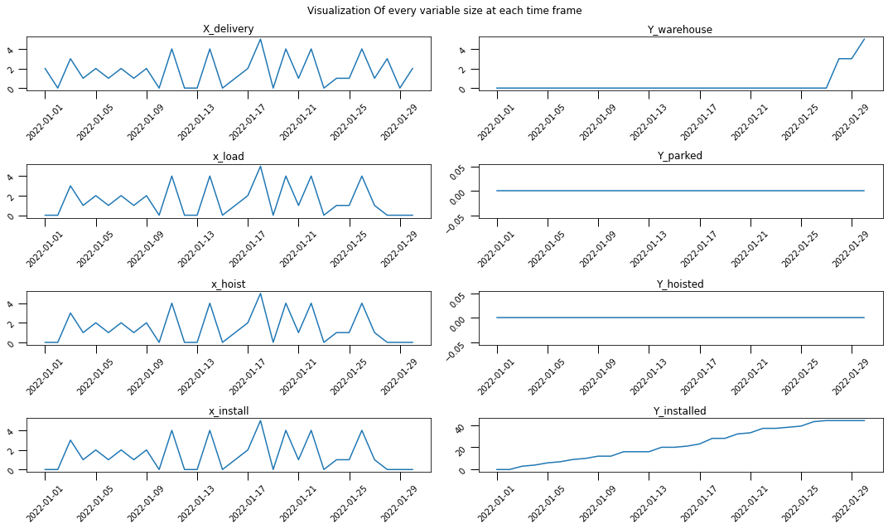
Simulation –Maximizing Installation

Slide 15
Simulation – Minimizing Warehouse and Maximizing Installation

Slide 16
Next Steps
1. Multi type of PBUs : Need adding more decision variables
2. Installation in the order of the floors : Need adding some extra constraint to the problem
^{Using Deep} Learning to predict delivery date using extra information such as order date shipping company and weather

